Slide 1
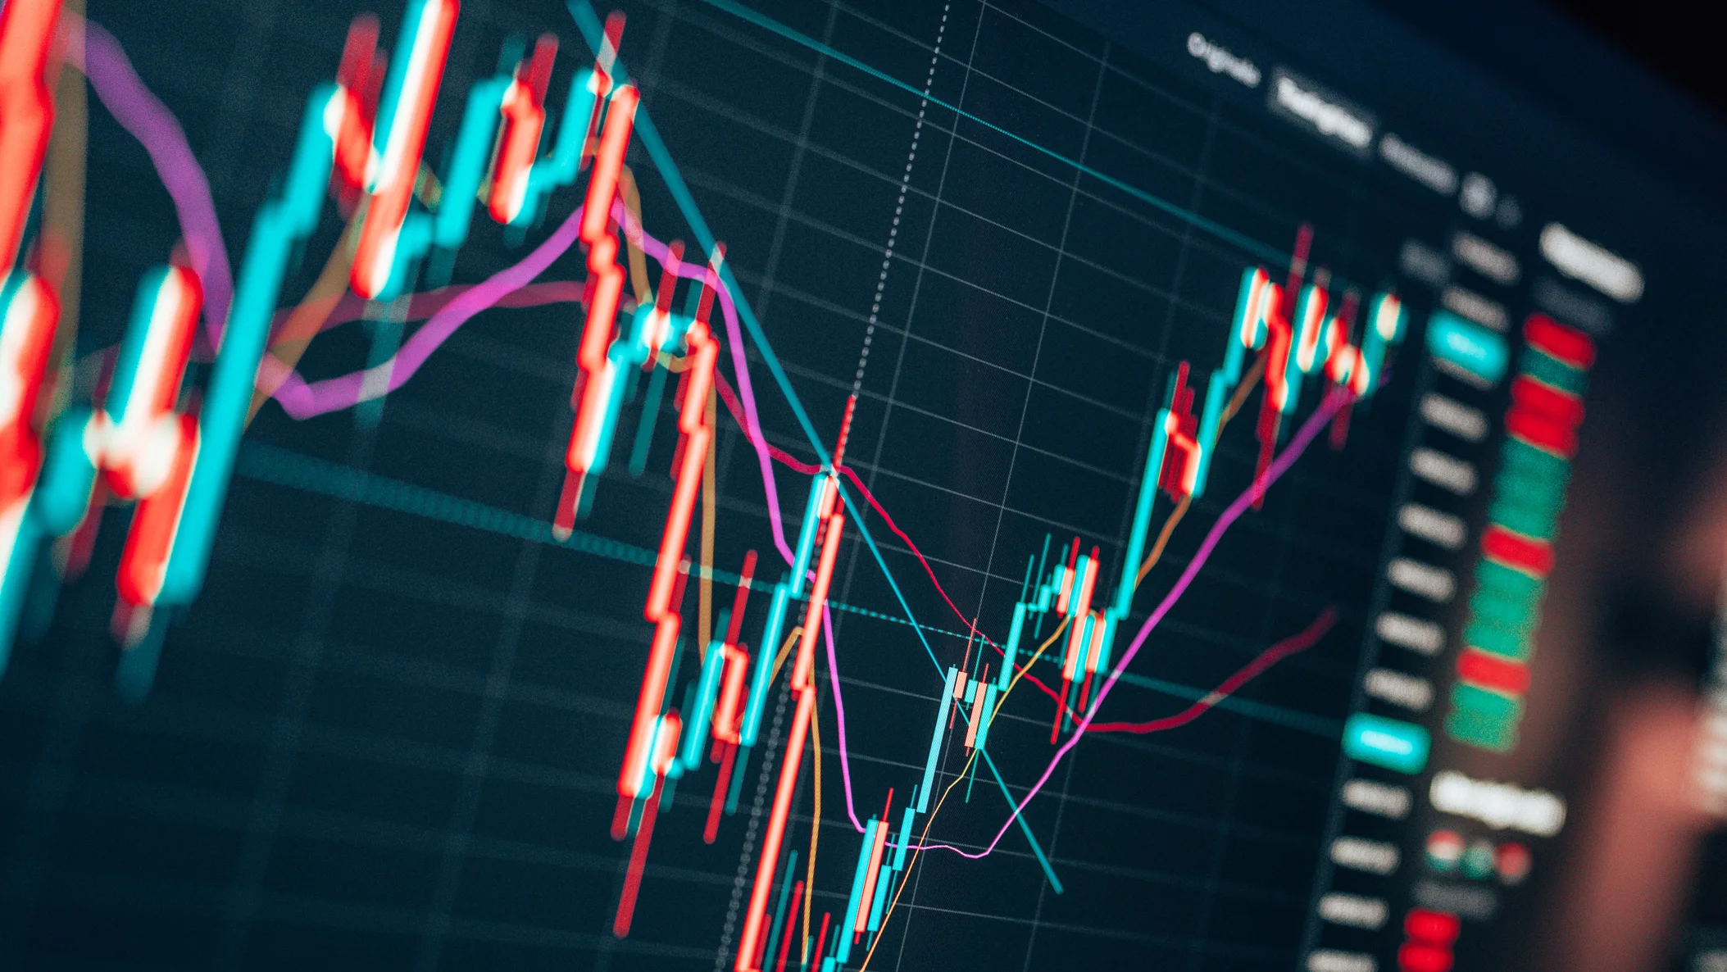
Data Wrangling Final Presentation Stock Analysis and Portfolio Construction
Presented by ZHUOFAN Dong and guangjian li

Slide 2
Introduction
Making investment decisions during the pandemic year
Market Research
Overview
Google Trends and Sentimental Analysis
Strategies
Build models based on skew and kurtosis, given the oscillating market.
Implementation
Portfolio construction and optimization

Slide 3
Overview of the dataset
S&P 500.csv
First 30 stocks from benchmark S&P 500 ranked by market capitalization.
Two variables: stock tickers and their market capitals
Get stock data from yahoo finance
Using package ‘quantmod’
India-news-headlines.csv
News headlines data from Kaggle(https://www.kaggle.com/datasets/therohk/india-headlines-news-dataset)
Three variables: publish_date, headline_category, headline_text

Slide 4
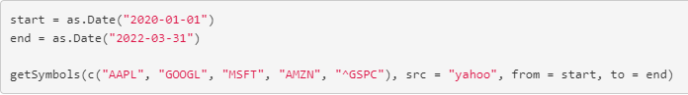
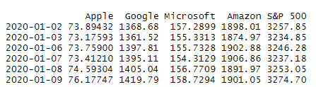
Part1:Data Overview

Slide 5
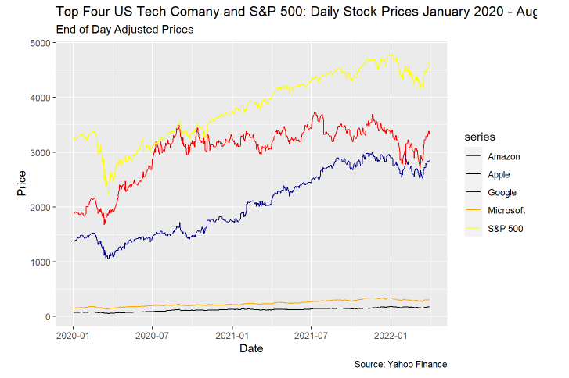
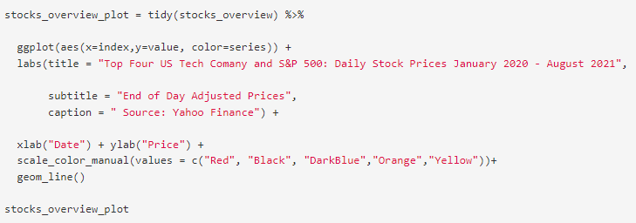

Slide 6
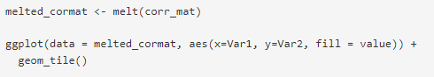
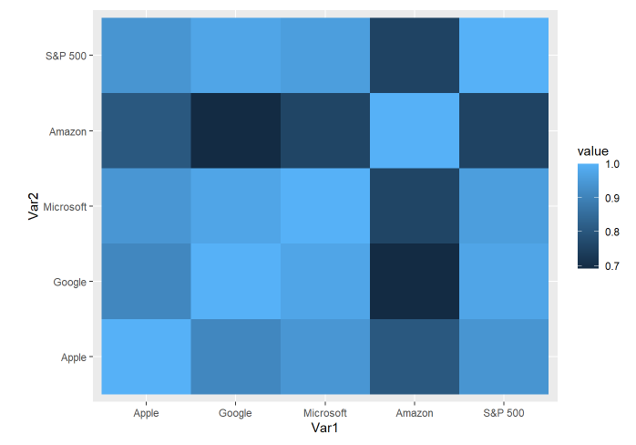
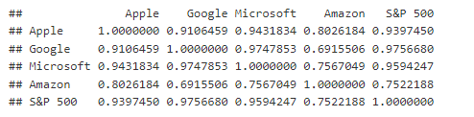
Correlation Matrix
It is quite clear that the correlation between the top 4 tech companies is pretty high. If we can make a profit from one ticker, we will also have the opportunity to make a profit by investing in others.

Slide 7
Part2:Sentimental Analysis
Benchmark overview
Google trends analysis
Sentimental analysis of news headlines

Slide 8
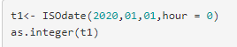
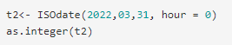
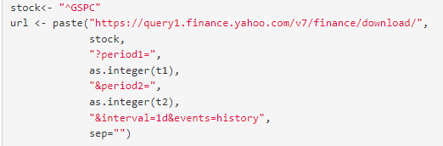
Benchmark Overview
We used a different way to web crawl the financial data

Slide 9
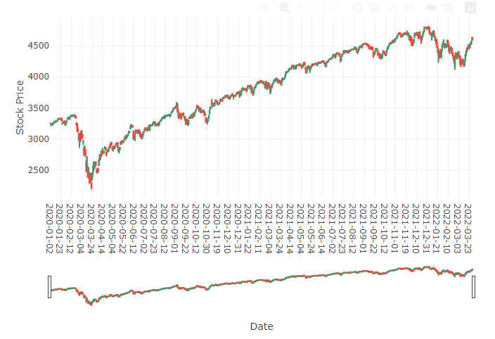
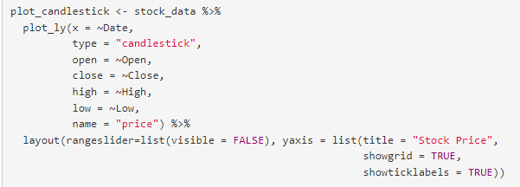
Candlestick plot

Slide 10
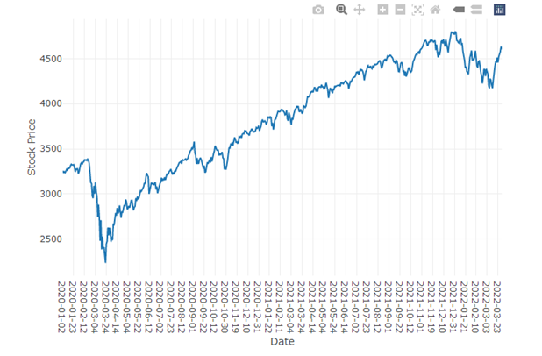
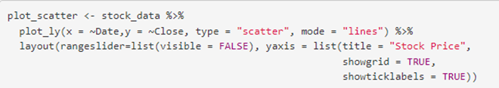
Scatter plot with mode = Lines

Slide 11
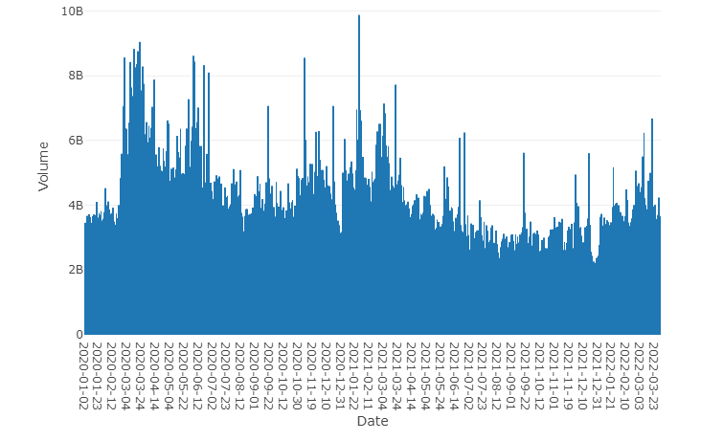
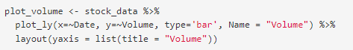
Volume plot

Slide 12
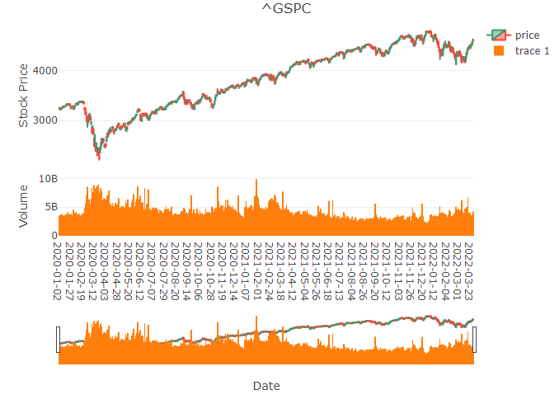
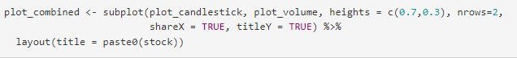
Combined plot It is clear that when the price goes down, the trading volume in the market is much higher than usual. The great liquidity of the market under such a scenario could be a good sign for us to make the investment decision.

Slide 13
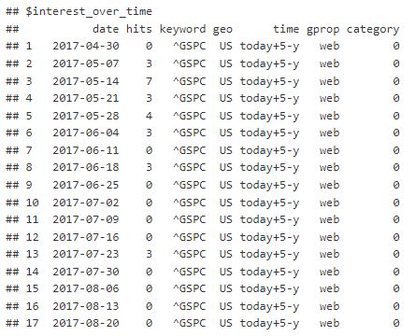
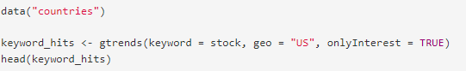
Google trends analysis by gtrends package

Slide 14
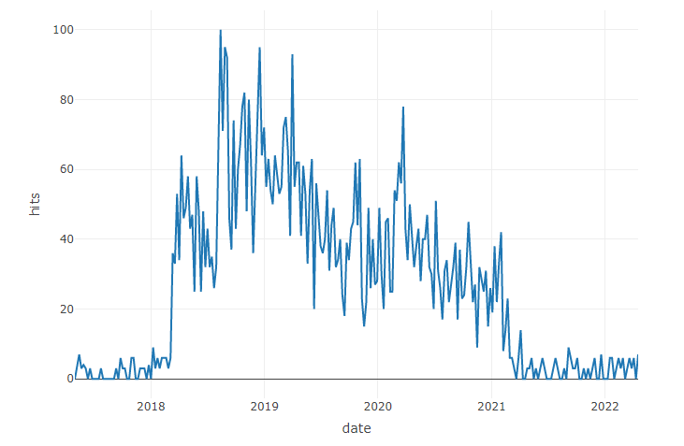
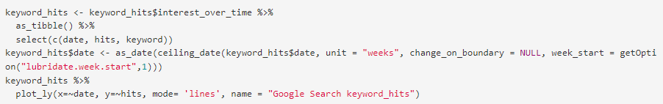
Google hits of the keywords over time

Slide 15
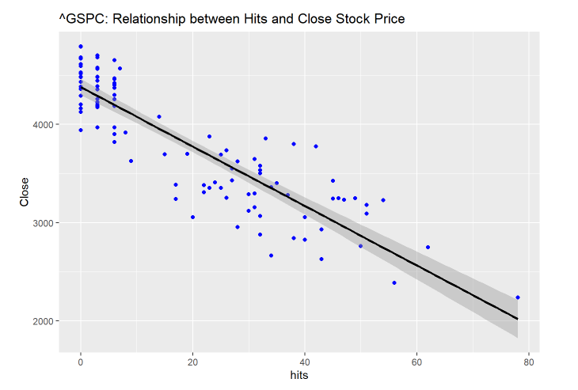
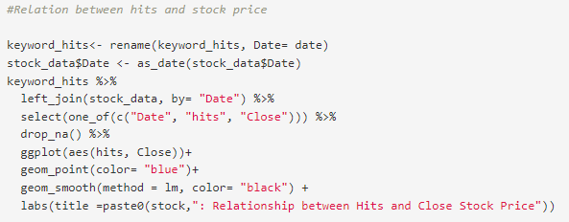
Relation between hits and stock prices As we can observe from the graph above, the lower the price, the more hits of google search. This means the investments in pandemic period are highly valued by the market.

Slide 16
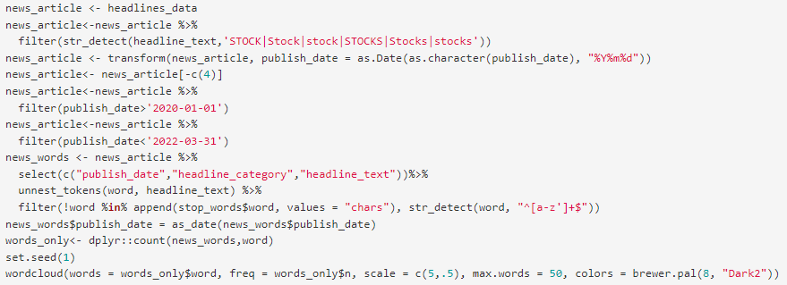
Sentimental Analysis

Slide 17
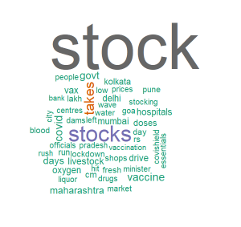

Slide 18
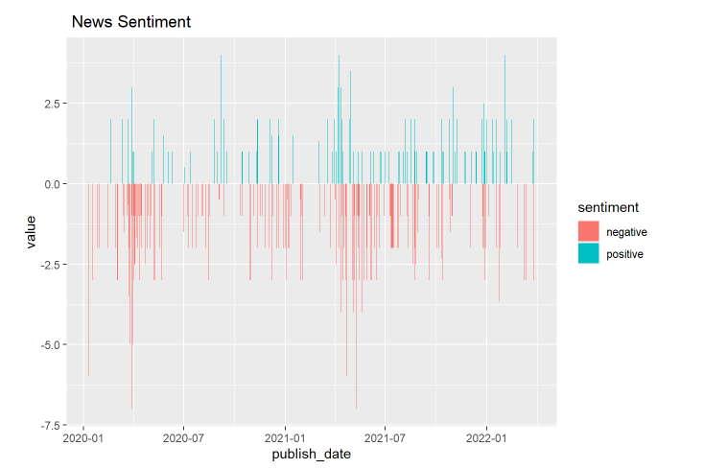
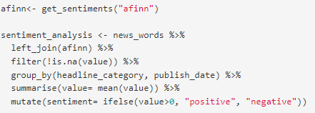
We can observe that most words in the headlines are negative, and the most frequent words along with stocks are mostly about the pandemic. It is reasonable to look for the investment opportunities during this period.

Slide 19
Part 3: Portfolio Optimization
In traditional models for equities, many models assume that the structure of stock follows a lognormal distribution, and the returns can be approximately normal. If an asset follows a normal return distribution, then from the mean and variance one could optimize a portfolio that takes advantage of the statistical qualities of each distribution and construct a portfolio to make excess returns. However, empirical evidence within the stock market datasets shows that the returns do not follow this assumption and that they exhibit significant skew and kurtosis within their returns which are respectively the third and fourth moments of expectation. In this project, we examine the relationship and explanatory power between skewness and returns and kurtosis and the realized volatility within a rolling 3-year window.

Slide 20
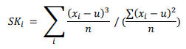
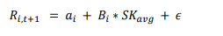
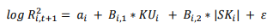
Methodology
In our Universe of the top 30 stocks in the SP500 by market cap the skewness of that universe is calculated for each asset and then averaged.
We then regress the averaged skewness for the universe against each asset’s returns for the next time.
An estimate for our expected return 63 days out is next calculated using the regressed coefficients and the next day realized quarterly average skewness.
The value of the kurtosis for each asset and the absolute skewness for the individual asset value is then regressed against the log realized variance

Slide 21
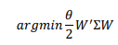
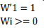
Optimization
We create a covariance matrix using last period correlations and the next period expected variance. “quadprog” program package in R is used for the optimization program as follows:
Such that
Tracking Error <= 0.03

Slide 22
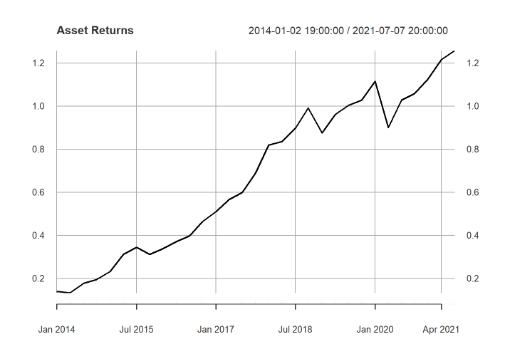
Results
Optimal Portfolio:

Slide 23
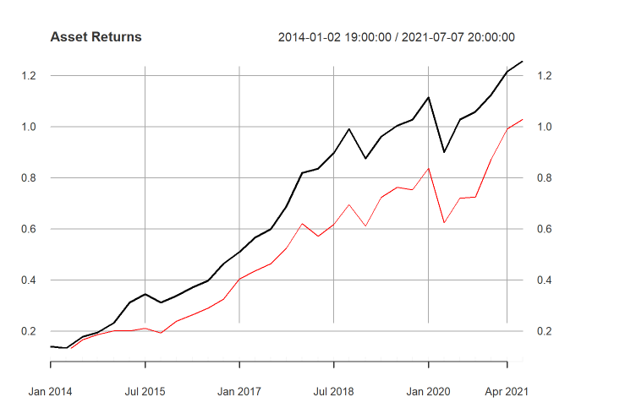
Results
Benchmark Portfolio:

Slide 24
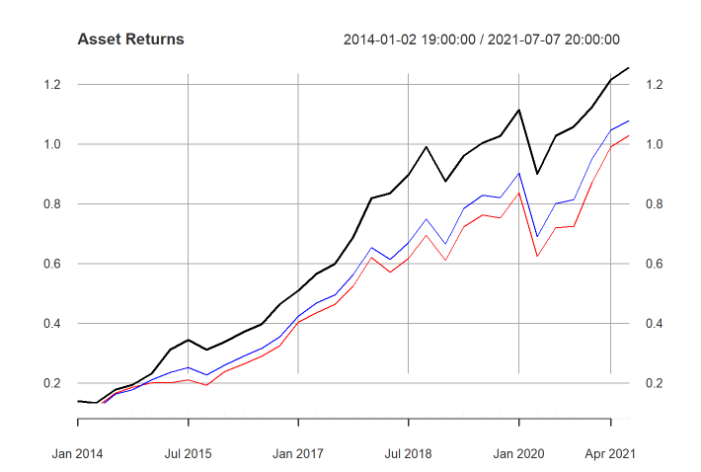
Results
Equally Weighted Portfolio :

Slide 25
Conclusion and Improvements
We can see that the data wrangling is able to guide us to make investment decisions through combining the data, visualizing the data, and conducting analysis.
An improvement in this project could be the advanced skills in sentimental analysis. It is much more proper to use US news headlines to perform sentimental analysis. We can improve the project by finding new data resources or R packages.

Slide 26
THANK YOU!
References:
https://www.tidytextmining.com/sentiment.html#:~:text=The%20AFINN%20lexicon%20assigns%20words,positive%20scores%20indicating%20positive%20sentiment.
Eric Jondeau, Qunzi Zhang, Xiaoneng Zhu, Average Skewness Matters, Journal of Financial Economics, Volume 134, issue 1, 2019, pages 29-47, ISSN 0304-405X, https://doi.org/10.1016/j.jfineco.2019.03.003.
Youngmin Choi, Suzanne S. Lee, Realized Skewness and Future Stock Returns: The Role of Information, 2004
https://www.kaggle.com/datasets/therohk/india-headlines-news-dataset
https://www.rdocumentation.org/packages/quadprog/versions/1.5-8/topics/solve.QP
https://www.sciencedirect.com/science/article/pii/S0304405X15001257
https://www.sciencedirect.com/topics/social-sciences/skewness
https://www.investopedia.com/terms/k/kurtosis.asp

